Slide 1


HTML
Web
Development
Essentials
Semantics, Elements, Forms, Tables, Assets & More
October 19, 2026

Slide 2



Understanding HTML
<!DOCTYPE html>
<html lang="en">
<head>
<title>Semantic Page</title>
</head>
<body>
<header>Site Header</header>
<nav>Navigation</nav>
<main>
<article>
<h1>Article Title</h1>
<p>Content goes here.</p>
</article>
</main>
Semantics
Semantc HTML gives structure and meaning to your content—making it accessible, discoverable, and easier to maintain.
Improves accessibility for all users
Boosts SEO with clearer content context
Enhances readability and maintainability
Creates a consistent, logical page structure

Slide 3







Core HTML
Elements Overview
Headings
Structure content
with clear hierarchy.
<h1>Page Title</h1>
Page Title
Paragraphs
Present text
in readable blocks.
<pThis is a paragraph
of text.</p>
This is a paragraph of text.
  Item one
  Item two
Lists
Organize items
in ordered or unordered formats.
<ul>
<li>Item one</li>
<li>Item two</li>
</ul>
Read more
Click me
Links
Connect to pages
and resources.
<a href="about.html">Read more</a>
Buttons
Trigger actions
and interactions.
<button>Click me</button>
Images
Add visual content
to your pages.
<img src="image.jpg" alt="Example image" />

Slide 4



Forms
in HTML
1 <form action="/submit" method="post">
2 <label for="name">Name</label>
3 <input type="text" id="name" name="name" required>
4
5 <label for="email">Email</label>
6 <input type="email" id="email" name="email" required>
7
8 <p>Preferred contact:</p>
9 <label>
10 <input type="radio" name="contact" value="email" checked>
11 Email
12 </label>
13 <label>
14 <input type="radio" name="contact" value="phone">
15 Phone
16 </label>
17 <button type="submit" Submit</button>
18 </form>
Build accessible, user-friendly input with semantic form elements.
Use form elements to collect
and submit user input
Support text fields, choices,
and longer responses
Validate input to ensure accurate,
secure data
Prioritize accessibility with labels,
help text, and clear feedback

Slide 5


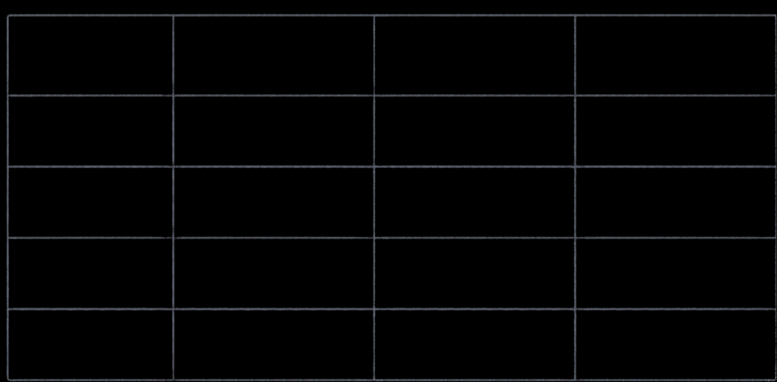

Working with Tables
Example: Quarterly Sales
Quarter
Product A
Product B
Product C
Tables organize information in rows and columns
Q1
$12,500
$9,300
$7,800
Q2
$14,200
$10,100
$8,400
Use the right elements
for clear structure
Q3
$15,700
$11,600
$9,200
Make tables accessible
with captions and scope
Q4
$16,900
$12,400
$10,300
Keep data readable
and easy to navigate
Accessibility Tips
Add a caption
to describe
the table
Use scope on headers to show relationships
Provide a summary when the table
is complex

Slide 6







Managing
HOME
FEATURES
ABOUT
JOURNAL
CONTACT
Assets
FEATURED
Exploring
the Highlands
Embed and optimise images and video for fast, accessible experiences.
A journey through dramatic landscapes and remote trails. Watch the story
and browse the gallery.
Use the right elements:
<img>, <video>, <picture>
Add alt text for images to support accessibility
Serve responsive images for all screen sizes
0:00 / 1:28
Include video controls
for a better user experience

Slide 7




Embedding External Content
<!-- Embed a YouTube video -->
<iframe width="560" height="315"
src="https://www.youtube.com/embed/dQw4w9WgXcQ"
title="YouTube video"
sandbox="allow scripts allow same-origin"
allow="accelerometer; autoplay; clipboard-write;
encrypted-media; gyroscope; picture-in-picture"
allowfullscreen</iframe>
Use <audio>, <iframe>, <embed>,
and <object> to bring in external media
<!-- Embed an audio player -->
<audio controls preload="metadata">
<source src="audio/sample-audio.mp3" type="audio/mpeg">
Your browser does not support the audio element.
/audio>
Embed videos and audio for richer experiences
Secure iframes with sandboxing
and limit permissions
Optimize performance with lazy loading
and efficient sources

Slide 8



Navigation & Links
<!-- navigation bar example -->
<nav>
Build clear navigation with the right links.
<ul>
<li><a href="index.html"Home</a><li>
Link types
<li><a href="about.html"About</a><li>
Internal, external, anchor links, mailto
<li><a href="/blog.html"Blog</a><li>
<li><a href="#contact">Contact</a><li>
<li><a href="https://example.com"
Navigation elements
Use <nav> for landmarks and <a> for links
target=_blank">External</a></li>
<li>ca href="mailto:hello@example.com">
Relative vs. absolute URLs
Email</a></li>
Relative: paths from your current page
Absolute: full URL with protocol and domain
</ul>
</nav>

Slide 9


Practical
Tools
Build faster. See changes instantly.
Live Server refreshes pages in real time
Modern editors and extensions streamline work
Version control keeps your progress safe
A smooth workflow from code to browser

Slide 10


<!DOCTYPE html>
<html lang="en">
<head>
<title>Thank You</title>
</head>
<body>
<main>
<p>Keep learning and building.</p>
</main>
</body>
</html>
Thank You & Next Steps
Thank you for exploring HTML essentials
Keep building and experimenting
Practice with the examples
Continue learning from trusted resources
RECOMMENDED RESOURCES
MDN Web Docs — developer.mozilla.org
W3Schools — www.w3schools.com

